Slide 1
Muslim Civilization
The Origins of Islam

Slide 2
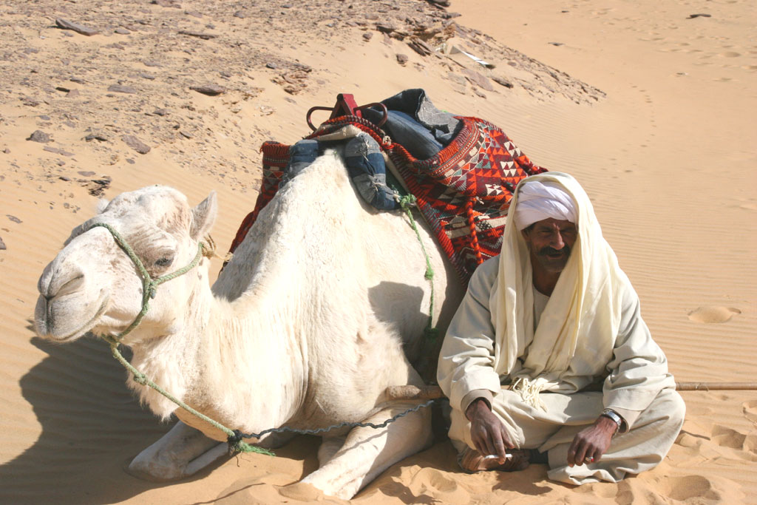
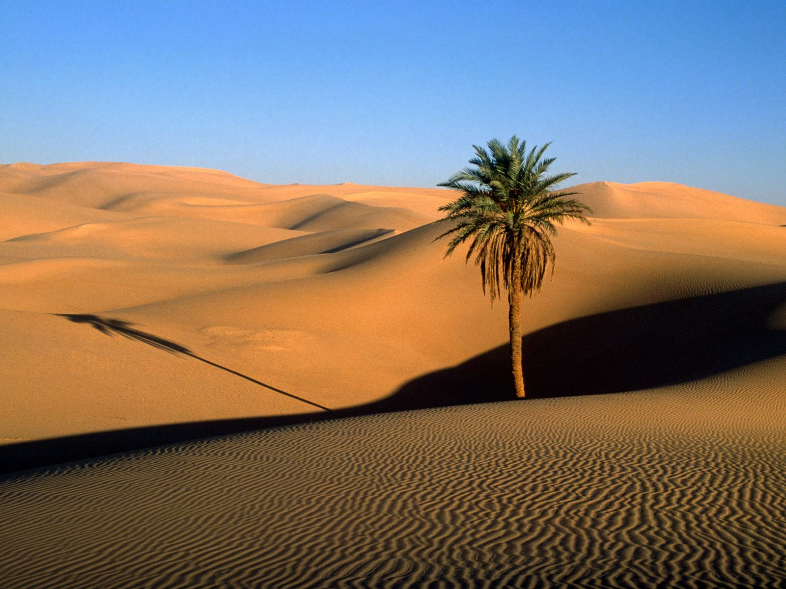
The Arabian Peninsula
A harsh land with large deserts
Small areas for farming called Oases
Populated by small groups of Arab nomads called Bedouins
Had values of courage and loyalty to their family/clan
Had great skills fighting
The first people to follow the religion of Islam
Connected to Africa, Europe and Asia

Slide 3
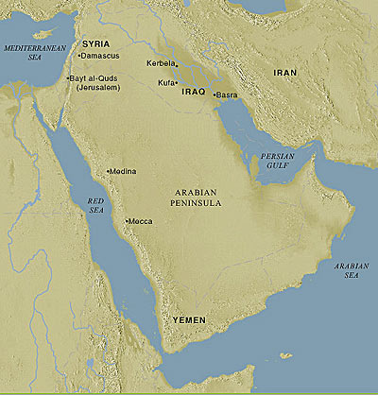

Slide 4
The Arabian Peninsula continued
Became a trading center that joined the East with the West
Trade ports and towns on the coast became important to the success of global trade
One of these important cities was Mecca near the Red Sea
Mecca was a religious city with the Kaaba stone at it’s center
The Kaaba stone was a religious building holding 360 idols of gods and goddesses
This was a sacred building built partially with a rock, said to have been a meteorite, “a piece of heaven”
One god, the Supreme god was considered above all the others and the people of Mecca called him Allah and worshipped him at the Kaaba stone

Slide 5
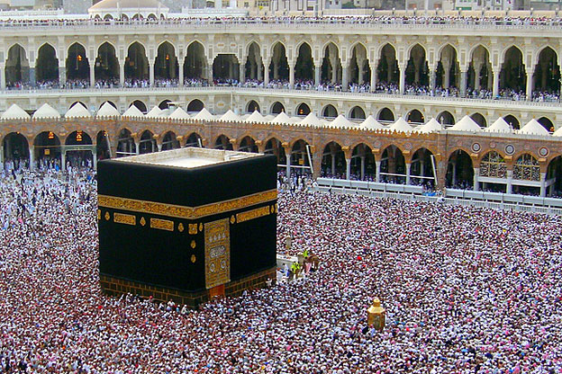
The Kaaba

Slide 6
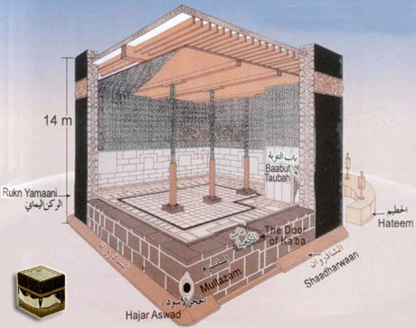
The Kaaba

Slide 7
Muhammad the Messenger
Muhammad’s Early Life
Born in 570 AD, orphaned at the age of 6, was raised by his uncle Abu Talib
By the age of 25 he was a successful businessman and trader in the city of Mecca
Married a widow named Khadijah, had 6 children together but only one lived to adulthood
As a trader he was exposed to many religions such as Christianity and Judaism
Some historians have made claims the Muhammad probably knew Christian preachers and parts of the Bible from missionaries spreading Christianity around the world

Slide 8
Muhammad the Messenger
Muhammad’s Early Life continued.
He was well known in his community for being religious and of good morals and character
Frequently went on retreats to a cave in the wild where he would pray and meditate on spiritual matters
Starting in the year 610 he had dreams where Allah spoke to Muhammad through an Angel.
Muhammad was commanded by Allah to share his dreams and messages with wife and close friends

Slide 9
Muhammad the Messenger
The Revelations (Dreams and Messages)
The messages from Allah received by Muhammad were…
Allah is the only true and powerful god
other messages were about how to live so they could go to heaven when they died
Muhammad had these dreams and messages for three years before he began to preach publicly the messages Allah had told him.
Muhammad preached new beliefs about worshipping only one god
This outraged the community as Mecca had become a center of trade for people who came to worship at the Kaaba stone.
Changing and altering the religion would hurt the businesses that made money from visitors to Mecca
Muhammad flees Mecca to avoid death threats

Slide 10
Muhammad the Messenger
Sharing the revelations
In 622 Muhammad finds acceptance in a city called Medina where people liked Muhammad and accepted his teachings
His journey from Mecca to Medina is known today by Muslims as the Hegira
Following his journey from Mecca to Medina he built up a community of believers and their faith became called “Islam”
Islam means - achieving peace through submission to god.
The followers of Islam were called Muslims
Muslim means - one who has submitted to god.
Notes:
The Islamic calendar begins in 622 marking it as year one

Slide 11
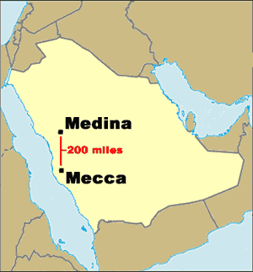
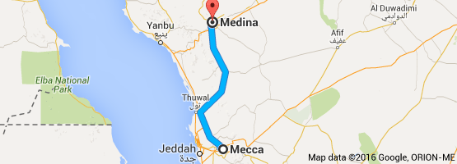
Travel time today in a car = 4 hours and 15 minutes

Slide 12
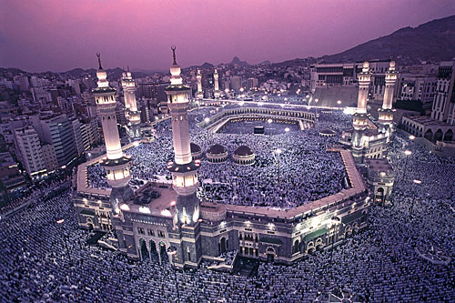
The Great Mosque in Mecca
Notes:
Masjid al-Haram
290 feet in height
holds 900,000 people at max capicity
builty in 638 AD

Slide 13
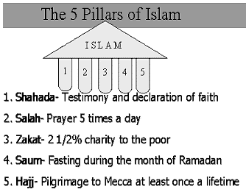
Basic Ideas of Islam
The religious book for all Muslims made up of the “messages” from Allah that were written down in a book, the Quran.
The Five Pillars of Islam
Testimony
5x a day prayer
giving to the poor
fasting
pilgrimage to mecca
Notes:
Testimony - “There is no god but allah and Muhammad is the messenger of God”
Prayer- Face mecca when praying
Give to the poor- a percentage of income, the more you give the higher place your receive in heaven when you die
Fasting - During the Month of Ramadan, no food or drink from dawn till dusk a way of showing god that he is more important than the body.
to Mecca - to pray in the mosque and pray around the kaaba stone 7 times

Slide 14
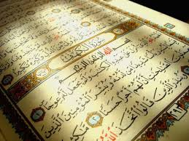
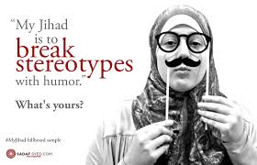
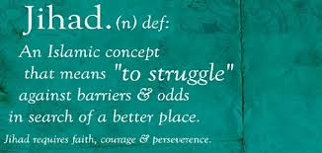
Basic Ideas of Islam
Guidelines for Behavior
The Quran provides directions on behaviors
Muslims are forbidden to eat pork or drink Alcohol
Must wash before praying to be pure before god
prohibits murder, lying and stealing
Jihad - literally translates as “struggle for the faith”
it can also mean to convert people to Islam
or it can also mean “holy war”

Slide 15
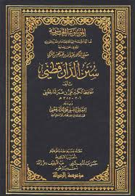
Basic Ideas of Islam
The Sunna and Sharia
The Quran describes the beliefs of Islam
The Sunna is a religious book that tells of how Muhammad acted and behaved in his daily life.
Sunna means - Tradition
hundreds of lessons on Muhammad's actions and daily life called “hadiths”
Sharia is a legal system that reflects the various rules all Muslims should live by

