Slide 1
The Basics of
Hinduism, Jainism &
Buddhism

Slide 2
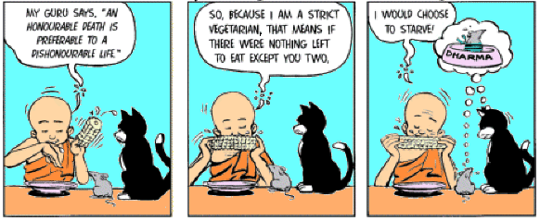
Hinduism
Dharma - A person’s spiritual duties and obligations, which he or she must follow to achieve liberation.

Slide 3
Hinduism
Karma - The sum effect of a person’s actions, both good and bad, which helps shape future experiences.

Slide 4
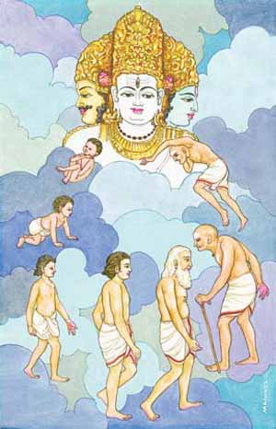
Hinduism
Samsara - Reincarnation; the cycle of birth, death, and rebirth a person follows before achieving liberation.

Slide 5
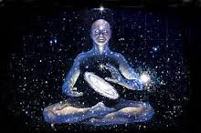
Hinduism
Moksha - Liberation; release from the cycle of reincarnation, and joining with the supreme being.

Slide 6
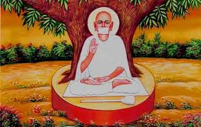
Jainism
Basic Beliefs:
non-ritual Hinduism (no Dharma to follow)
Ahimsa - non-violence to all creatures of earth
Vegetarian
Promise to always tell the truth and avoid stealing
Strive to eliminate:
greed
anger
prejudice
gossip
Strive to achieve Moksha
No earthly possessions
live outside
Sweep as they walk to avoid killing insects on the ground

Slide 7
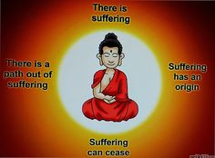
Buddhism
The Four Noble Truths -
Suffering is a part of human life. No one can escape from suffering while alive
Suffering comes from people’s desires for pleasure and material goods.
overcoming these desires during life eventually brings suffering to an end.
Desires can be overcome by following the eightfold path
There is suffering
Suffering comes from somewhere
Suffering can come to an end
There is a way out of suffering

Slide 8
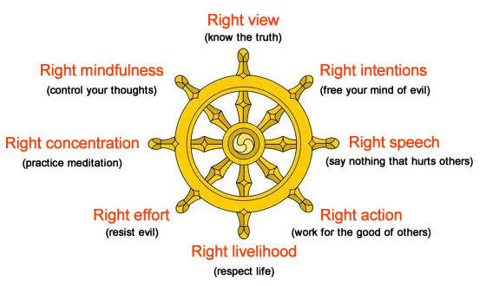
Buddhism
The Eightfold Path
Right view, or accepting the reality of the Four Noble Truths
Right attitude, or striving for moderation in all things
Right speech, or avoiding lies, boasts and hurtful words
Right livelihood, or avoiding jobs that could bring harm to others
Right effort, or constantly trying to improve oneself
Right mindfulness, or remaining aware of the world around one
Right concentration, or ignoring temptation and discomfort while meditating

Slide 9
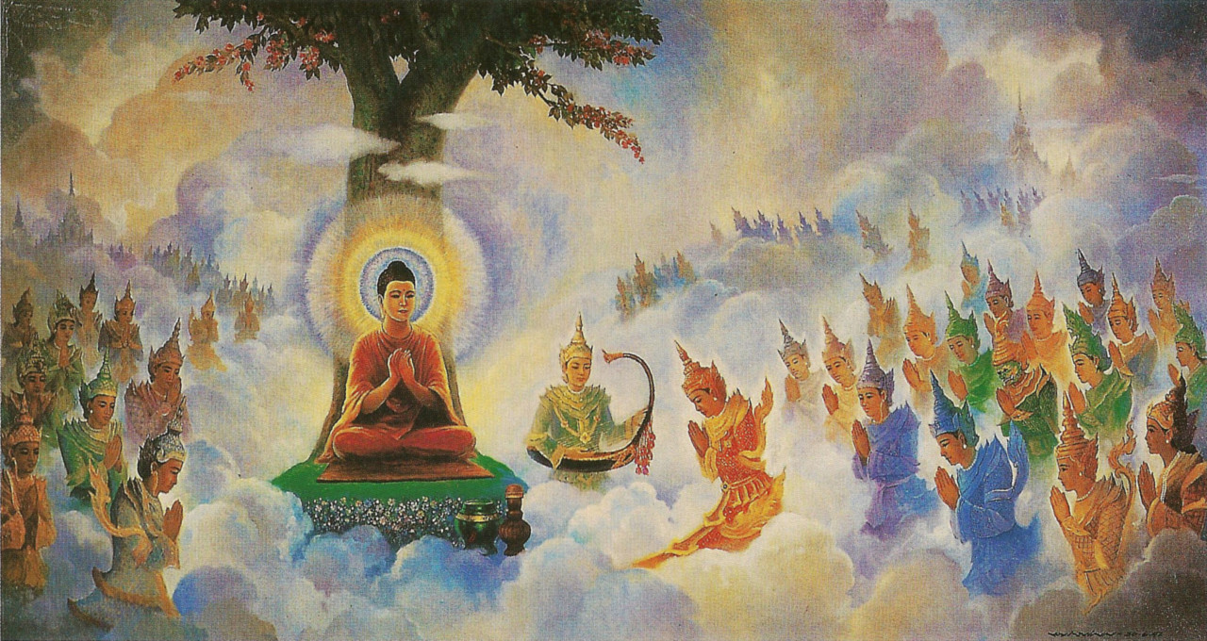
Buddhism
Nirvana - A state of perfect peace in which the soul would be free from suffering forever. Those who do not attain nirvana will be reborn to live through the cycle of suffering again.

Slide 10
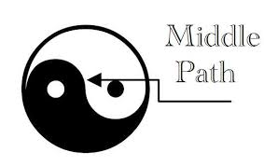
Buddhism
The Middle Way - In the simplest form, the Middle Way advises people to live in moderation, avoiding the extremes of either comfort or discomfort in the search for nirvana.
“There are two extremes… which he who has given up the world ought to avoid. What are these two extremes? A life given to pleasures, devoted to pleasures and lusts: this is degrading, sensual, vulgar, not honorable and profitless; and a life given to mortifications: this is painful, not honorable and profitless.”
~The Buddha, Sermon at Benares, c. 528 BC

