Slide 1
Unit 1: River Valley Civilizations
Day 1: Map Skills, Dating, and Early Humans

Slide 2
What is History?
The chronological record of human events emphasizing causes and effects
Perspectives can be biased.

Slide 3
What kind of tools can a historian use?
Artifacts: objects made by humans
Primary Source Documents: created during the time period being studied
Secondary Source Documents: created about a time period.
Examples?

Slide 4
Primary v. Secondary
Number 1-11 in your notebook. Write P for primary and S for secondary.
1. The Declaration of Independence
2. Wikipedia page about WWII
3. History Textbook about Christopher Columbus’s journey
4. The diary of Anne Frank
5. Letter from a Japanese student who survived the atomic bomb
6. Book published in 1994 about the
Middle Passage.
7. A journal of a girl growing up in the 1950’s
8. Your Twitter handle
9. A student essay about religion in the United States
10. Video shot from a cell phone camera of the twin towers on 9/11
11. The picture of the US troops putting the flag up at Iwo Jima

Slide 5
Map Skills
Latitude
lines run east and west but measure in degrees north and south of the equator
Also can be used to for climate zones
Longitude
lines run north and south but measure in degrees east and west of the prime meridian
also used to measure time zones
1 hour= 15 degrees

Slide 6
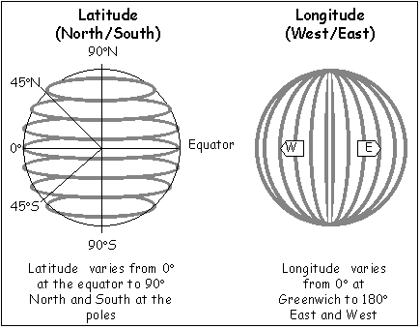

Slide 7
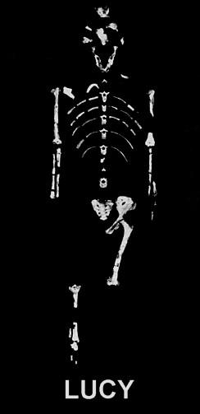
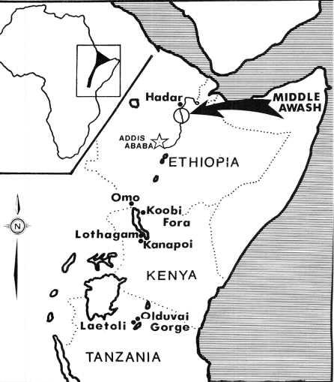
The Earliest Humans
Where have archeologists found the earliest evidence for human beings?
Humans originated in the Great Rift Valley of East Africa around 3 million years ago
Paleolithic Culture (Stone Age)- 2.5 million years ago stone tools begin to be used
1.5 million years ago first evidence of controlling fire
Hunter Gatherers: food supply depended on hunting animals and collecting wild plants
groups were nomadic, small, and highly mobile
Started leaving Africa around 125,000 years ago

Slide 8
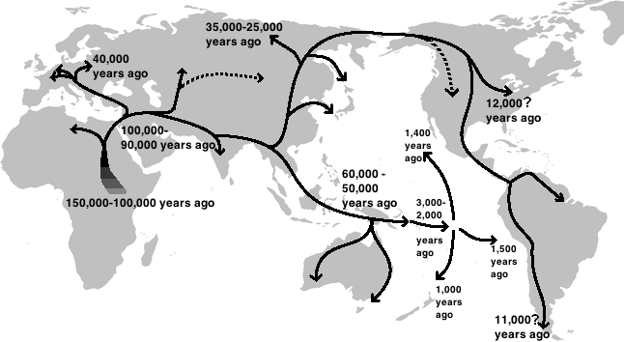
Migration out of Africa, Why?
Competition with other humans
Following the animal herds
Human curiosity

Slide 9
Revolution
- With your neighbor brainstorm a definition or meaning of the word Revolution.

Slide 10
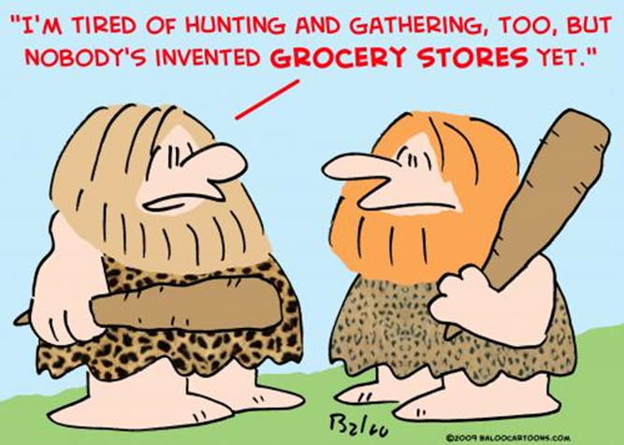
The Neolithic Revolution
Also known as the First Agricultural Revolution (8000 BCE)
The domestication of plants and animals
FARMING= CROP SURPLUSES, SETTLEMENTS= SPECIALIZATION= CIVILIZATION.
Societies that did not develop farming independently or through cultural diffusion remained nomadic or vulnerable to conquest

Slide 11
Rise of Civilization
How did Agriculture change life for humans?
Villages Grow into Cities
What happens as people become better at farming?
How would you finish this thought?
-Fact: When your community has a food surplus,....
Eventually what will happen to the number of farmers?
How would this impact people’s roles/jobs in a society?

Slide 12
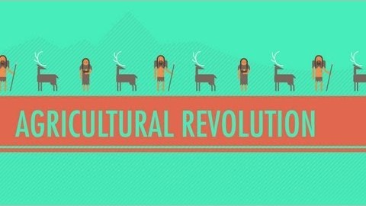
Crash Course World History: Agricultural Revolution

Slide 13
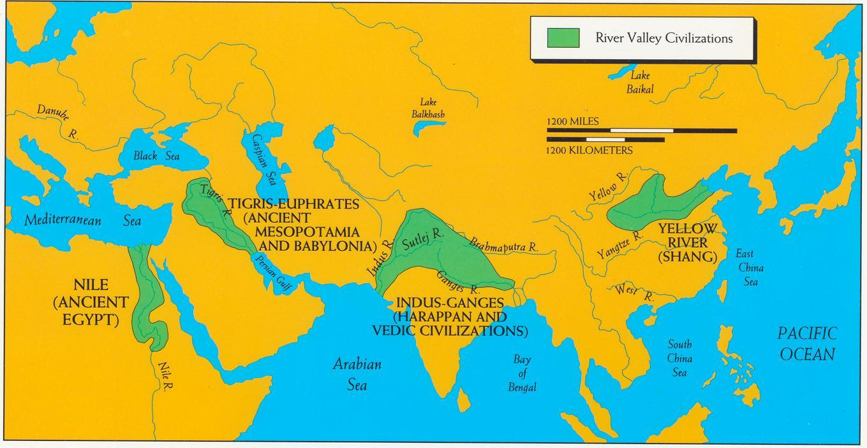
First Civilizations
What common geographical feature do these civilizations have?

